Slide 1
Capstone Engagement
Assessment, Analysis, and Hardening of a Vulnerable System

Slide 2
Table of Contents
This document contains the following sections:
01
Network Topology
02
Red Team: Security Assessment
03
Blue Team: Log Analysis and Attack Characterization
Hardening: Proposed Alarms and Mitigation Strategies
04

Slide 3
Network Topology
‹#›

Slide 4
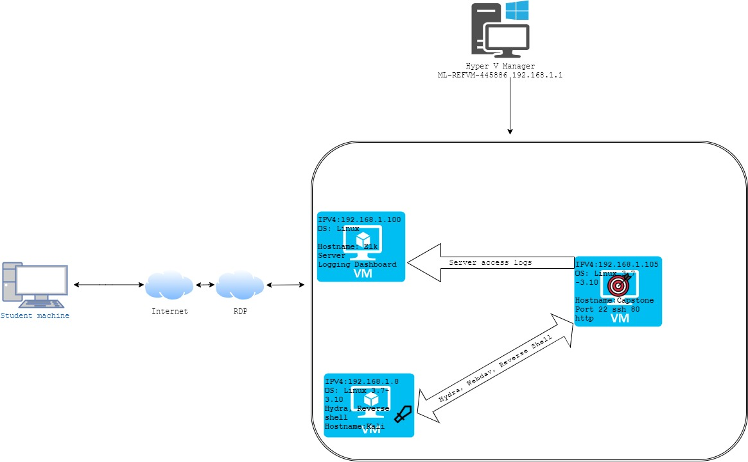
Network Topology
[Insert Here]
Use draw.io to create a diagram of the network.
Add your diagram to this slide and fill out the data in the sidebar.
Network
Address Range:
192.168.1.1 - 192.168.1.254
Netmask: 255.255.255.0
Gateway: 192.168.1.1
Machines
IPv4: 192.168.1.8
OS: Linux kali 4.18.0-kali2-amd64
Hostname: Kali
IPv4: 192.168.105
OS: Ubuntu 18.04.1 LTS
Hostname: Capstone
IPv4: 192.168.1.100
OS: Ubuntu 18.04.3 LTS
Hostname: Elk
IPv4: 192.168.1.1
OS: Windows 10 Pro
Hostname: ML-REFVM-445886

Slide 5

Red Team
Security Assessment
‹#›

Slide 6
Recon: Describing the Target
Nmap identified the following hosts on the network:
Hostname | IP Address | Role on Network
No name returned from nmap (ML-REFVM-445886) | 192.168.1.1 | Gateway
ELK | 192.168.1.100 | Log Search and Metrics Dashboard/SErver
Capstone | 192.168.1.105 | Target Machine
Kali | 192.168.1.8 | Pentesting Machine, Attacker

Slide 7
Vulnerability Assessment
The assessment uncovered the following critical vulnerabilities in the target:
Vulnerability | Description | Impact
Browsable Web Directories. | Web server allows remote directory browsing | An attacker can perform recon on server directory, potentially exposing directories not meant for public access
Publicly accessible admin authentication page | Admin login page is accessible publicly | Allows public access to admin login
No Account Lockout | Site allows unlimited failed login attempts | Allows attacker to brute force login
Web-dav access not host-restricted | Any client can connect to Web-Dav | Remote attacker can connect to web server from any client machine and upload malware

Slide 8
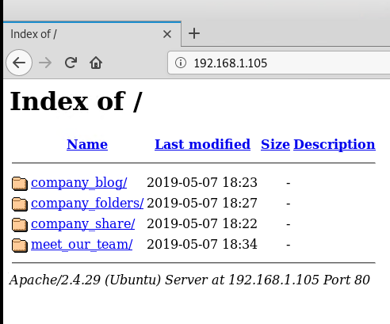
Exploitation: Browsable Web Directories
01
02
03
Tools & Processes
Visiting the site displays the web server directory.
Achievements
Was able to find the secret_folder

Slide 9
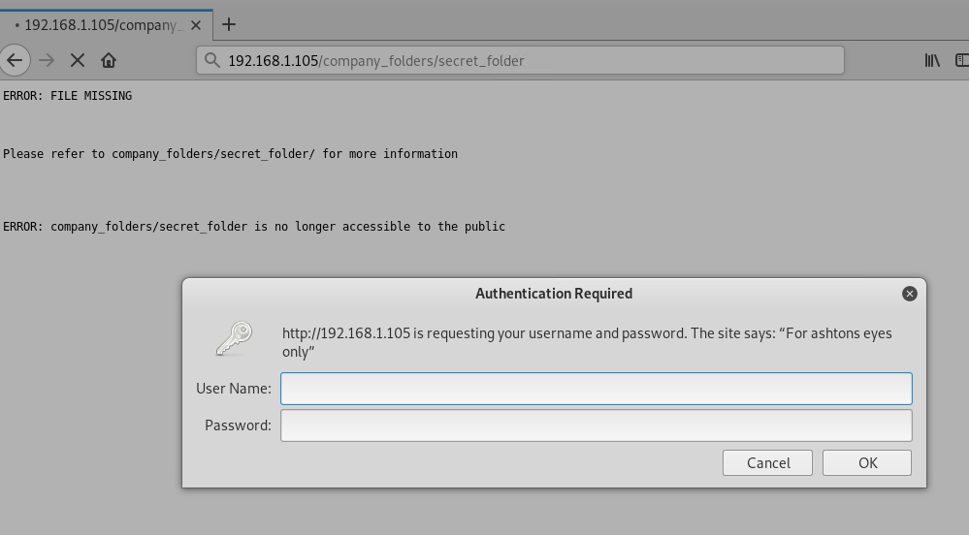
Exploitation: Publicly Accessible Admin Login Page
01
03
Tools & Processes
Using the browser, was able to navigate to the hidden authentication page
Achievements
Access to Admin login page
02

Slide 10
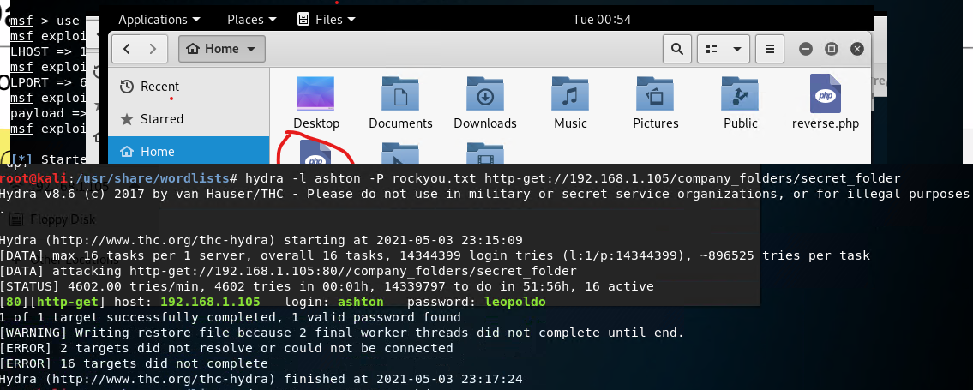
Exploitation: No Account Lockout
01
03
Tools & Processes
Used Hydra to brute force ashton's password
Achievements
Cracked Ashton's password
02

Slide 11
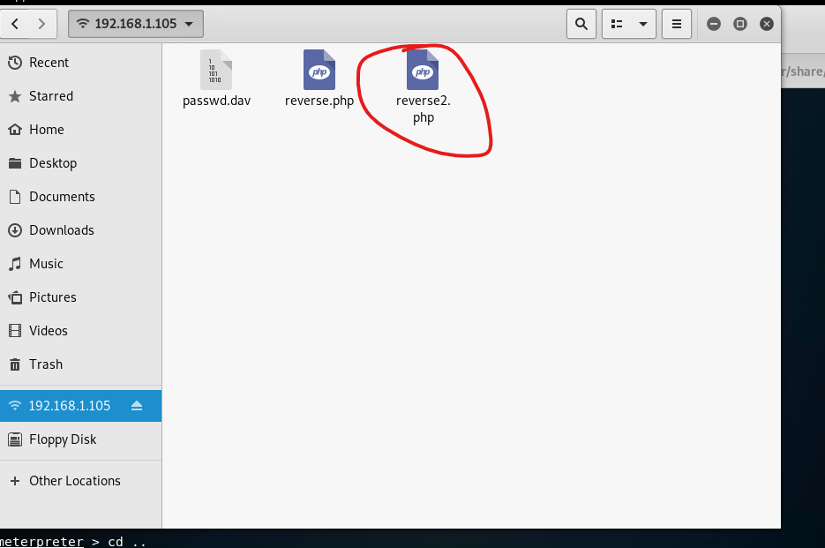
Exploitation: Web-Dav access not host-restricted
01
03
Tools & Processes
After gaining admin password, was able to establish web-dav connection from attack machine
Achievements
Uploaded reverse-shell exploit to web server
02

Slide 12

Blue Team
Log Analysis and Attack Characterization
‹#›

Slide 13

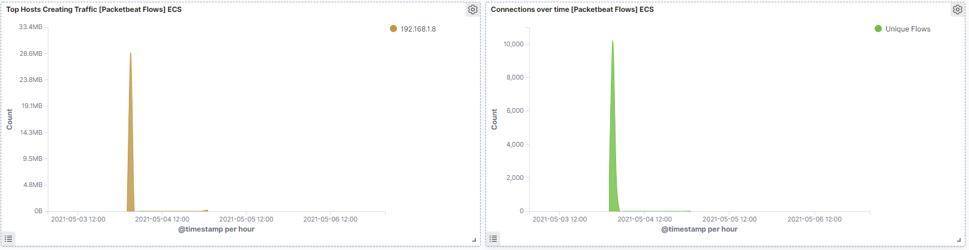
Analysis: Identifying the Port Scan
Answer the following questions in bullet points under the screenshot if space allows. Otherwise, add the answers to speaker notes.
What time did the port scan occur?
How many packets were sent, and from which IP?
What indicates that this was a port scan?
[Insert Here]
Include a screenshot of Kibana logs depicting the port scan.
Notes:
What time did the port scan occur? 4 May 0300
How many packets were sent, and from which IP? 10,217
What indicates that this was a port scan? The increase of traffic being created from the Kali host at one given time

Slide 14
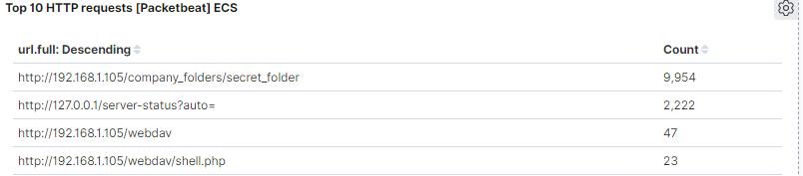
Analysis: Finding the Request for the Hidden Directory
Answer the following questions in bullet points under the screenshot if space allows. Otherwise, add the answers to speaker notes.
What time did the request occur? How many requests were made?
Which files were requested? What did they contain?
[Insert Here]
Include a screenshot of Kibana logs depicting the request for the hidden directory.
Notes:
What time did the request occur? 4 May 0300 How many requests were made? 9,954
Which files were requested? In the solution file it states that the files requested would have been for the /connect _to_corporate_server. However, ours did not have that request. So, the files requested for us was just for the secret folder. What did they contain? The secret_folder contained the instructions to connect to the webdav.

Slide 15
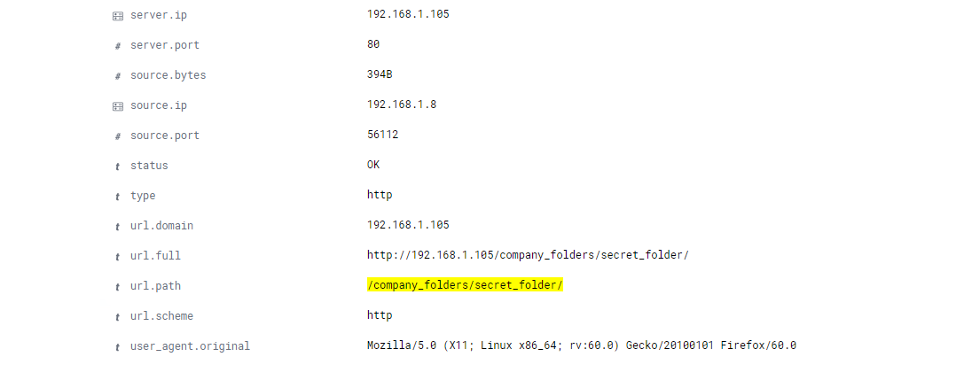
Analysis: Uncovering the Brute Force Attack
Answer the following questions in bullet points under the screenshot if space allows. Otherwise, add the answers to speaker notes.
How many requests were made in the attack?
How many requests had been made before the attacker discovered the password?
[Insert Here]
Include a screenshot of Kibana logs depicting the brute force attack.
Notes:
How many requests were made in the attack? 9,954
How many requests had been made before the attacker discovered the password? 9,949

Slide 16
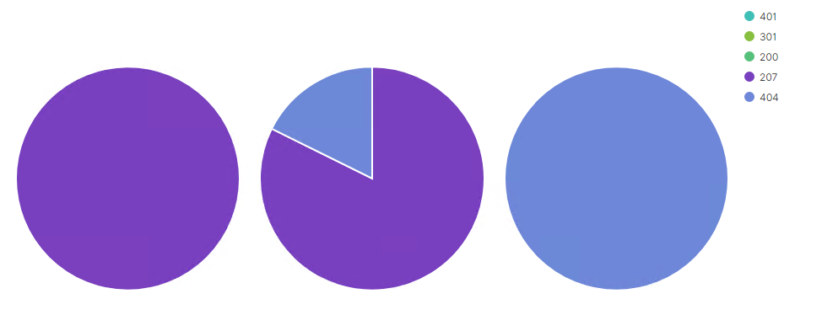
Analysis: Finding the WebDAV Connection
Answer the following questions in bullet points under the screenshot if space allows. Otherwise, add the answers to speaker notes.
How many requests were made to this directory?
Which files were requested?
[Insert Here]
Add a screenshot of Kibana logs depicting the WebDAV connection.
Notes:
How many requests were made to this directory? 47
Which files were requested? shell.php

Slide 17
Blue Team
Proposed Alarms and Mitigation Strategies
‹#›

Slide 18
Mitigation: Blocking the Port Scan
What kind of alarm can be set to detect future port scans?
Alert when a port scan is detected, drop connections from source when port scan is detected
What threshold would you set to activate this alarm?
When same source IP accesses more than 4 ports in 4 minutes
What configurations can be set on the host to mitigate port scans?
Describe the solution. If possible, provide required command lines.
On the host (if no external firewall available):
-Configure iptables to drop connections from offending IPs

Slide 19
Mitigation: Finding the Request for the Hidden Directory
What kind of alarm can be set to detect future unauthorized access?
Alert if hidden directory is accessed by an unauthorized source IP
What threshold would you set to activate this alarm?
At the first attempt by an unauthorized source
What configuration can be set on the host to block unwanted access?
Restrict access to the hidden directory by configuring .htaccess file to allow only a specific IP or IP range and additionally add authentication.
1. By IP, add the following to .htaccess file:
Order allow, deny
Deny from all
Allow from x.x.x.x
2. Setup password authentication for the page as well by adding the appropriate lines to .htaccess and an accompanying password file (like .htpasswd).

Slide 20
Mitigation: Preventing Brute Force Attacks
What kind of alarm can be set to detect future brute force attacks?
What threshold would you set to activate this alarm?
alert on 401 errors > 5 per second
What configuration can be set on the host to block brute force attacks?
1. Restrict access to authentication page (such as using .htaccess)
2. Lockout accounts after a number of failed attempts
3. Increment a password authentication delay after a number of failed attempts
4. Block offending IP for a period of time
Describe the solution. If possible, provide the required command line(s).

Slide 21
Mitigation: Detecting the WebDAV Connection
What kind of alarm can be set to detect future access to this directory?
Create an alert anytime it is accessed by a different machine other than the one that should only have access
What threshold would you set to activate this alarm?
Whenever someone accesses the webdav directory from an unauthorized IP/host
What configuration can be set on the host to control access?
1. Enable MFA for access to webdav
2. Restrict access to shared files and folders by IP / network
Describe the solution. If possible, provide the required command line(s).

Slide 22
Mitigation: Identifying Reverse Shell Uploads
What kind of alarm can be set to detect future file uploads?
we could set an alert for `.php` files that are uploaded to the server.
What threshold would you set to activate this alarm?
Anytime an executable code or file is transferred.
What configuration can be set on the host to block file uploads?
1. Remove the ability to upload files to the directory through a web interface.
2. Require MFA to upload files
3. Upload files to a directory that is not accessible via web
Describe the solution. If possible, provide the required command line.

